Slide 1
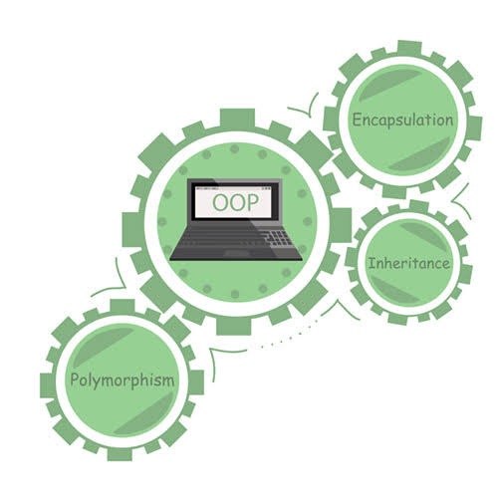

Object Oriented Paradigm
Topic: JAVA

Slide 2

Contents
Encapsulation and Data Hiding
Local and Global Variables
Packages

Slide 3
Encapsulation
Mechanism to wrap up variables(data) and methods(code) together as a single unit.
If you are creating class, you are doing encapsulation.
Hides the implementation details from users.
If a data member is private it means it can only be accessed within the same class. No outside class can access private data member (variable) of other class.

Slide 4
Encapsulation
We setup public get() and set() methods to update and read the private data fields.
The outside class can access those private data fields via public methods.
This way data can only be accessed by public methods thus making the private fields and their implementation hidden for outside classes. That’s why encapsulation is also known as data hiding.
&
Private Members
Public get and set methods

Slide 5
How to implement encapsulation in java:
Make the instance variables private so that they cannot be accessed directly from outside the class. You can only set and get values of these variables through the methods of the class.
Have getter and setter methods in the class to set and get the values of the fields.

Slide 6
Execution
Compiles the package
javac -d directory javafilename
This forces the compiler to create the “MyPackage" package.
The -d keyword specifies the destination for where to save the class file.
You can use any directory name, like c:/user (windows), or, if you want to keep the package within the same directory, you can use the dot sign ".",
javac -d . Compare.java
To run:
java MyPackage.Compare

Slide 7
class EncapsulationDemo{
private int empAmrita;
private String empName;
private int empAge;
//Getter and Setter methods
public int getEmpAmrita(){
return Amrita;
}
public String getEmpName(){
return empName;
}
public int getEmpAge(){
return empAge;
}
public void setEmpAge(int newValue){
empAge = newValue;
}
public void setEmpName(String newValue){
empName = newValue;
}
public void setEmpAmrita(int newValue){
empAmrita = newValue;
}
}
public class EncapsTest{
public static void main(String args[]){
EncapsulationDemo obj = new EncapsulationDemo();
obj.setEmpName("Mario");
obj.setEmpAge(32);
obj.setEmpAmrita(112233);
System.out.println("Employee Name: " + obj.getEmpName());
System.out.println("Employee Amrita: " + obj.getEmpAmrita());
System.out.println("Employee Age: " + obj.getEmpAge());
}
}
Employee Name: Mario
Employee Amrita: 112233
Employee Age: 32

Slide 8
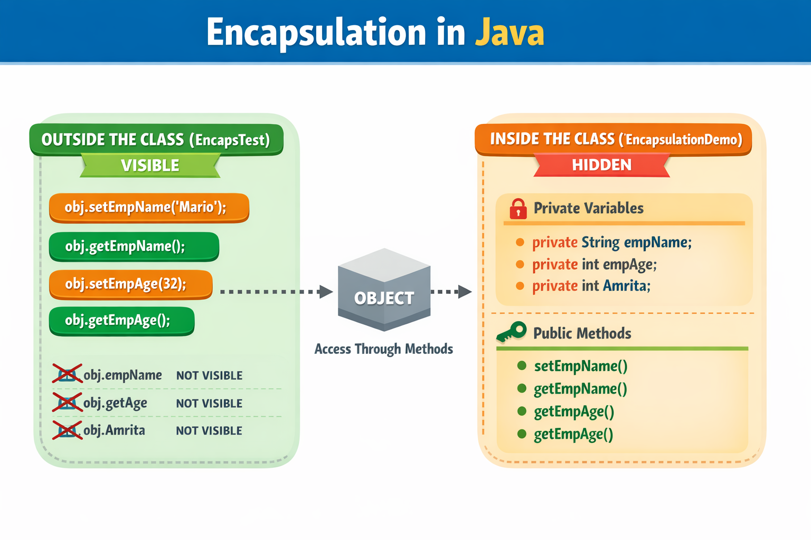

Slide 9
Advantages of Encapsulation
It improves maintainability and flexibility and re-usability
The fields can be made read-only.
Eg: If we have a field(or variable) that we don’t want to be changed so we simply define the variable as private and instead of set and get both we just need to define the get method for that variable. Since the set method is not present there is no way an outside class can modify the value of that field.
Data Hiding: The user will have no idea about the inner implementation of the class. It will not be visible to the user that how the class is storing values in the variables. He only knows that we are passing the values to a setter method and variables are getting initialized with that value.
Testing code is easy: Encapsulated code is easy to test for unit testing.

Slide 10
package MyPackage; // this class belongs to Mypackage
public class Compare {
int num1, num2;
Compare(int n, int m)//constructor automatically runs when new Compare(5, 10)
{
num1 = n;
num2 = m;
}
public void getmax(){
if ( num1 > num2 ) {
System.out.println("Maximum value of two numbers is " + num1);
}
else {
System.out.println("Maximum value of two numbers is " + num2);
}
}
public static void main(String args[])
// Array of objects, creates array that holds 3 compare objects, current[0],current[1],current[2]
{
Compare current[] = new Compare[2];
current[0] = new Compare(5, 10);
current[1] = new Compare(123, 120);
for(int i=0; i < 2 ; i++)
{
current[i].getmax();
}
}
}
javac -d . Compare.java
java MyPackage.Compare
Maximum value of two numbers is 10
Maximum value of two numbers is 123

Slide 11
Abstraction vs. Encapsulation
Encapsulation is more about "How" to achieve a functionality.
Abstraction is more about "What" a class can do.
A simple example to understand this difference is a mobile phone. Where the complex logic in the circuit board is encapsulated in a touch screen, and the interface is provided to abstract it out.

Slide 12
Local Variables
Local variables are declared in methods, constructors, or blocks.
They are created when the method, constructor or block is entered and the variable will be destroyed once it exits the method, constructor, or block.
Access modifiers cannot be used for local variables.
Local variables are visible only within the declared method, constructor, or block. These variables are implemented at stack level internally.

Slide 13
Local Variables
Global Variables
public class Demo {
public void Rank() {
int rank = 0; //local variable, belongs only to Rank()
rank = rank + 7;
System.out.println("Rank = " + rank);
}
public static void main(String args[]) {
Demo d = new Demo();
d.Rank();
}
}
There is NO such concept of Global Variables in Java.
We can have static variables to have the scope of global variables.

Slide 14
Example
class Counter {
static int x = 0;
public static void main(String[] args) {
Counter.x = 10;
System.out.println(Counter.x); // 10
}
}
You can access x anywhere using:
Counter.x
So we say,
Static variables behave like global variables.
Even static variables are:
Still inside a class
Still controlled by access modifiers
Not truly global like C/C++

Slide 15
Packages
A mechanism to encapsulate a group of classes, sub packages and interfaces.
We put related classes into packages. After that, we can simply write an import class from existing packages and use it in our program. A package is a container of a group of related classes where some of the classes are accessible are exposed and others are kept for internal purpose.
The Java API is a library of prewritten classes
The library is divided into packages and classes.
You can either import a single class or a whole package that contain all the classes of it.

Slide 16
Packages
Packages
Built-in Packages
User-defined Packages
Predefined packages that come as a part of JVM to simplify the task of Java programmer.
Eg: java.lang, java.io, java.util, java.applet,
java
Package
lang
util
awt
Sub-Packages
System.class
String.class
Arraylist.class
Map.class
Button.class
Classes

Slide 17
Creating Packages
package MyPackage;
The package statement simply specifies to which package the classes defined belongs to..
Including class in JAVA package
Declare the package name as the first statement of your program.
Then include the class as part of the package. But, remember that, a class can have only one package declaration.

Slide 18
Built-in Packages
import java.util.Scanner;;
User defined Packages
User-defined packages are those which are developed by users in order to group related classes, interfaces and sub packages.

Slide 19
Demo.java
package SecondOne;
import MyPackage.Compare;
public class Demo{
public static void main(String args[]) {
int n=10, m=10;
Compare current = new Compare(n, m);
if(n != m) {
current.getmax();
}
else {
System.out.println("Both the values are same");
}
}
}
//Using fully qualified name instead of import
MyPackage.Compare current = new MyPackage.Compare(n, m);
Both the values are same

Slide 20
Java packages addresses four categories of visibility for class members:
Sub-classes in the same package
Non-subclasses in the same package
Sub-classes in different packages
Classes that are neither in the same package nor sub-classes
 | Private | No Modifier | Protected | Public
Same Class | Yes | Yes | Yes | Yes
Same Package Subclasses | No | Yes | Yes | Yes
Same Package Non-Subclasses | No | Yes | Yes | Yes
Different Packages Subclasses | No | No | Yes | Yes
Different Packages Non- Subclasses | No | No | No | Yes

Slide 21
THANK YOU….

